Slide 1

RoboNox 2020
Team voltage

Slide 2
TABLE OF CONTENT:
INTRODUCTION
GOALS AND BENEFITS
DESIGN
COST
WORKFLOW

Slide 3

INTRODUCTION:
Are you tired of the mistakes made by your employees while segregating the parcels, do your parcels get lost while in transit and never reach the right customers on time , then don’t worry! for that we bring to you an automated system that will end all your troubles. It will segregate your parcels based on the area pin codes with 99.9999999% accuracy your parcels will never get lost and your customers will always be satisfied. Ok now back to the topic our automated system will unload your parcels check them using the best image/barcode scanning technology , segregate them and deliver the segregated parcels in different carts. We use the highly stable raspberry 3 processor and highly durable servo motors so that you definitely get what you pay for.

Slide 4
Goals and benefits : Our goal is to automate the complete unloading and separation process for incoming packages based on pin codes.
Faster and more efficient.
Reduces human labour
Reasonable price

Slide 5
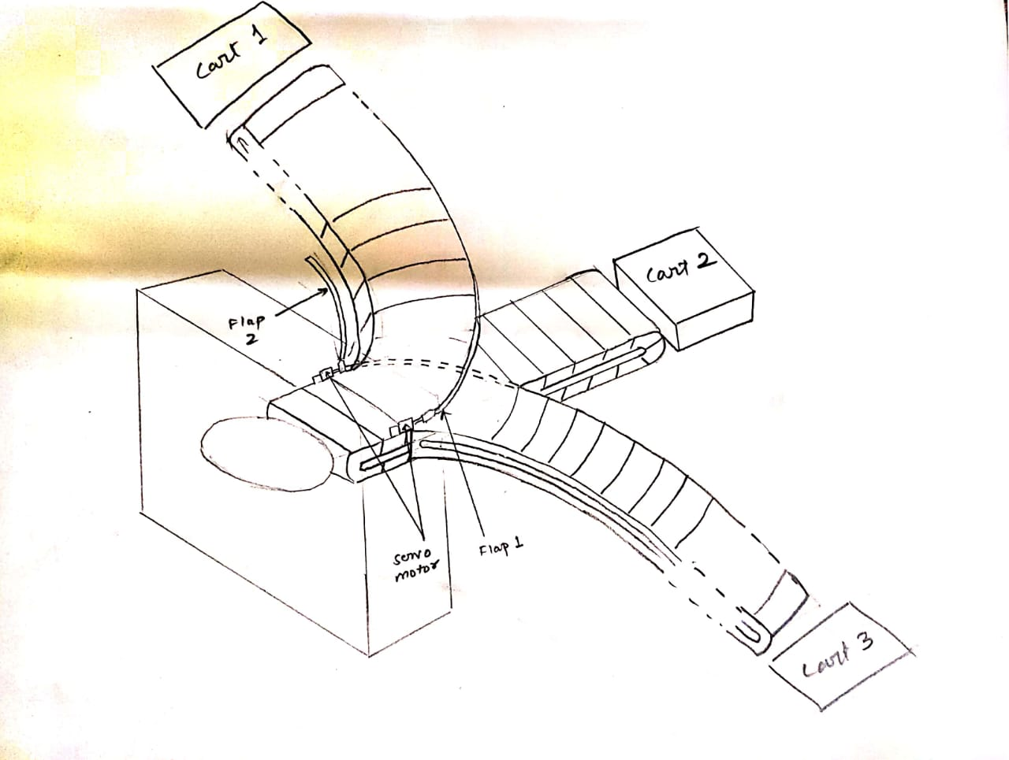
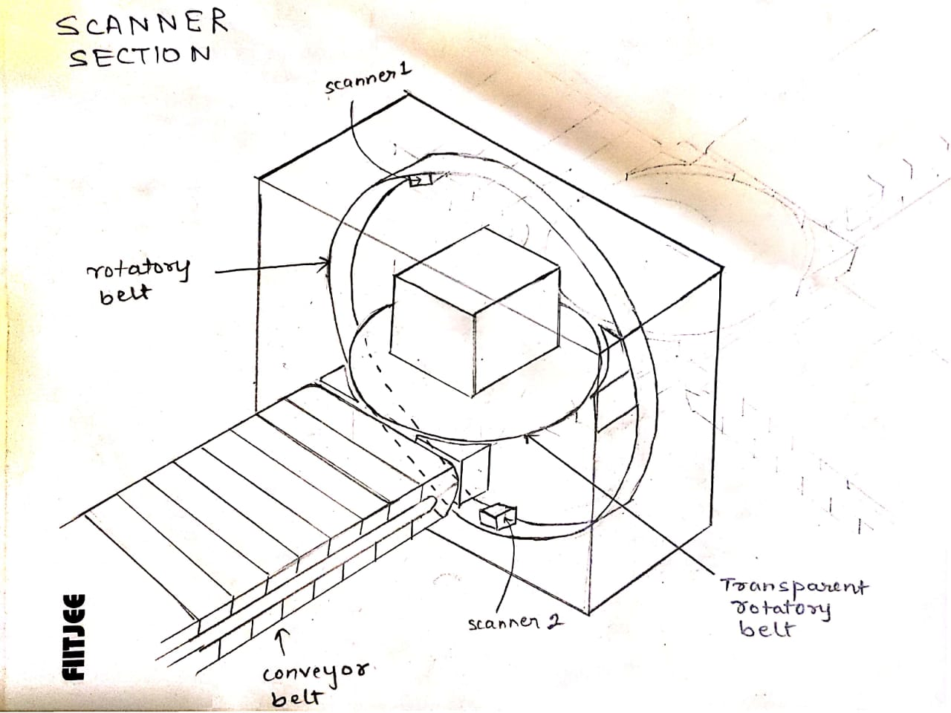
DESIGN and COST estimation:
Scanner
Conveyor belts
Main components: 3 raspberry pi, 2 dc motor, 2cameras, 2 battery, 2motor drivers, breadboard, 2servo motor
Cost around 3K
Cost around 10K
Unloading machine
It uses the Siemens's RUBUS method.
Cost around 2k

Slide 6
Workflow:

Slide 7
Unloading the packages:
We start with the unloading of the packages of the blocks in such a manner so that the packages are not piled up (like Siemens’s RUBUS).
After unloading, we move the packages over a conveyor belt and on its way, it is passed through a scanner.

Slide 8
SCANNER:
After the unloading, we move the packages over a belt and on its way, it is passed through a scanner .
Scanner has 2 cameras which rotates accordingly on the belt to scan the barcode.
Base of the scanner also rotates in a round way to make it easy for scanner to cover all the sides of the package.
After reading the barcode a flap is used to segregates the packages accordingly.

Slide 9
Loading the packages:
A flap is used to push the packages on the respective belts for the packages to reach their respective carts.
Conveyor belt is used to transfer the packages to the cart.
Then the loading machine loads the packages to the carts.

Slide 10

tHanks

